Slide 1
JAVA SEMINAR
2. Querying the Database books. Write a program which allows the user to enter any query into the program. The program should displays the result of a query in a JTable, using an object TableModel to provide the data to the JTable.

Slide 2
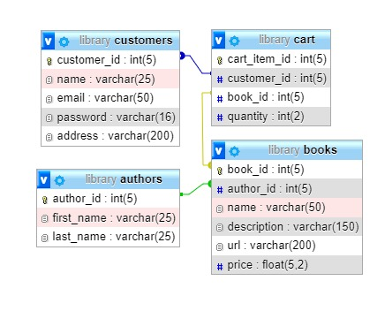
DATABASE

Slide 3
STEPS:
Create jframe.
Create appropriate javaFx control objects like JTextArea, Buttons and Jtable.
Create result set table model object for the table, creates database connection in constructor.

Slide 4
STEPS:
Define relevent functions in the above mentioned class like setQuery, getColumnName, getColumnClass, getRowCount, getColumnCount, getValueAt.
Add on click listener to submit button sends entered query to setQuery function, which in turn gets result set object for that query, then updates the table by calling inbuild function fireTableStructureChanged.

Slide 5
STEPS:
In submit listener, the filter regex text is taken as input and the values in the table is sorted using TableRowSorter's regexFilter function.

Slide 6
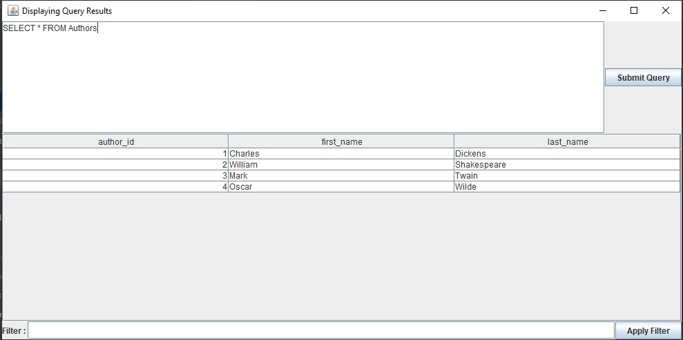
OUTPUT:

Slide 7
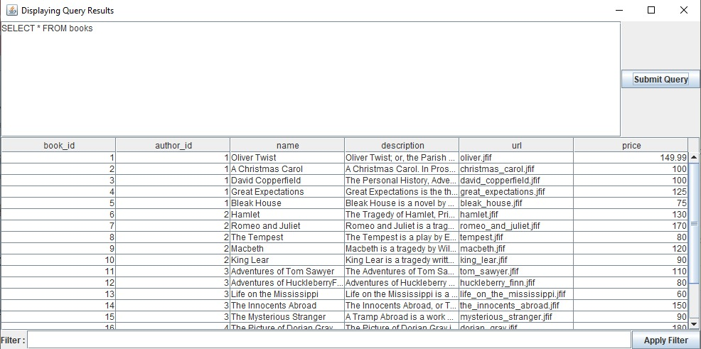
OUTPUT:

